Slide 1
DiscoverIT IFA Internship Detection App
George Patrașc
Ferencz Cârnu

Slide 2
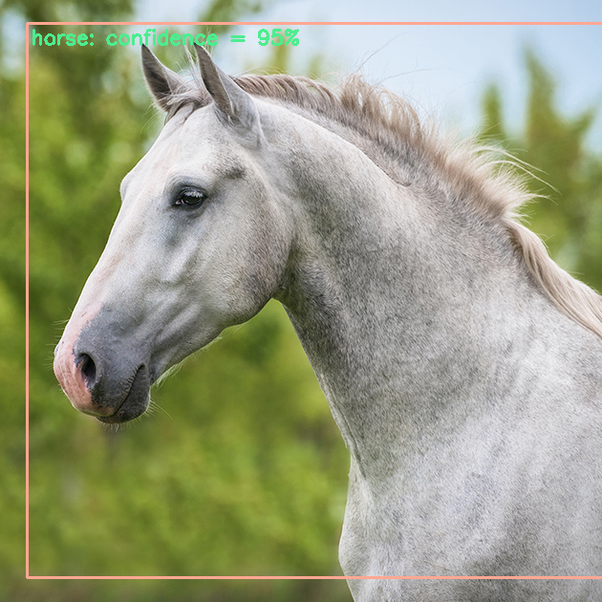
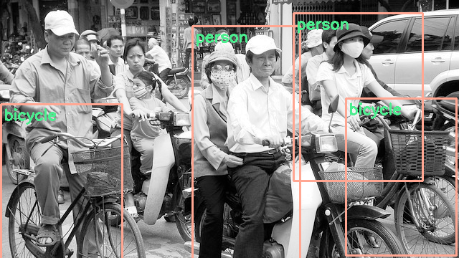
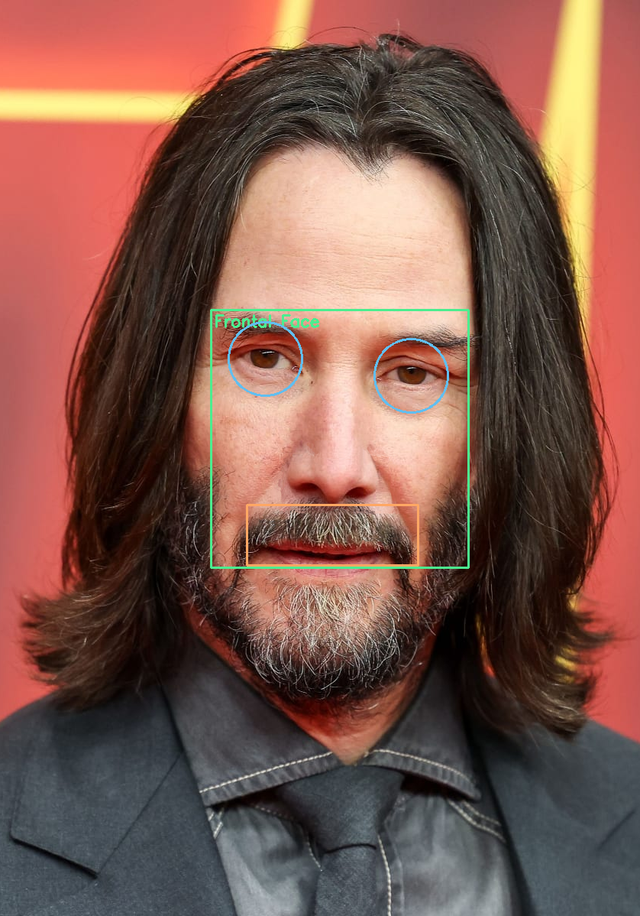
Desktop application to showcase the use of object detection models from web camera from uploaded image

Slide 3
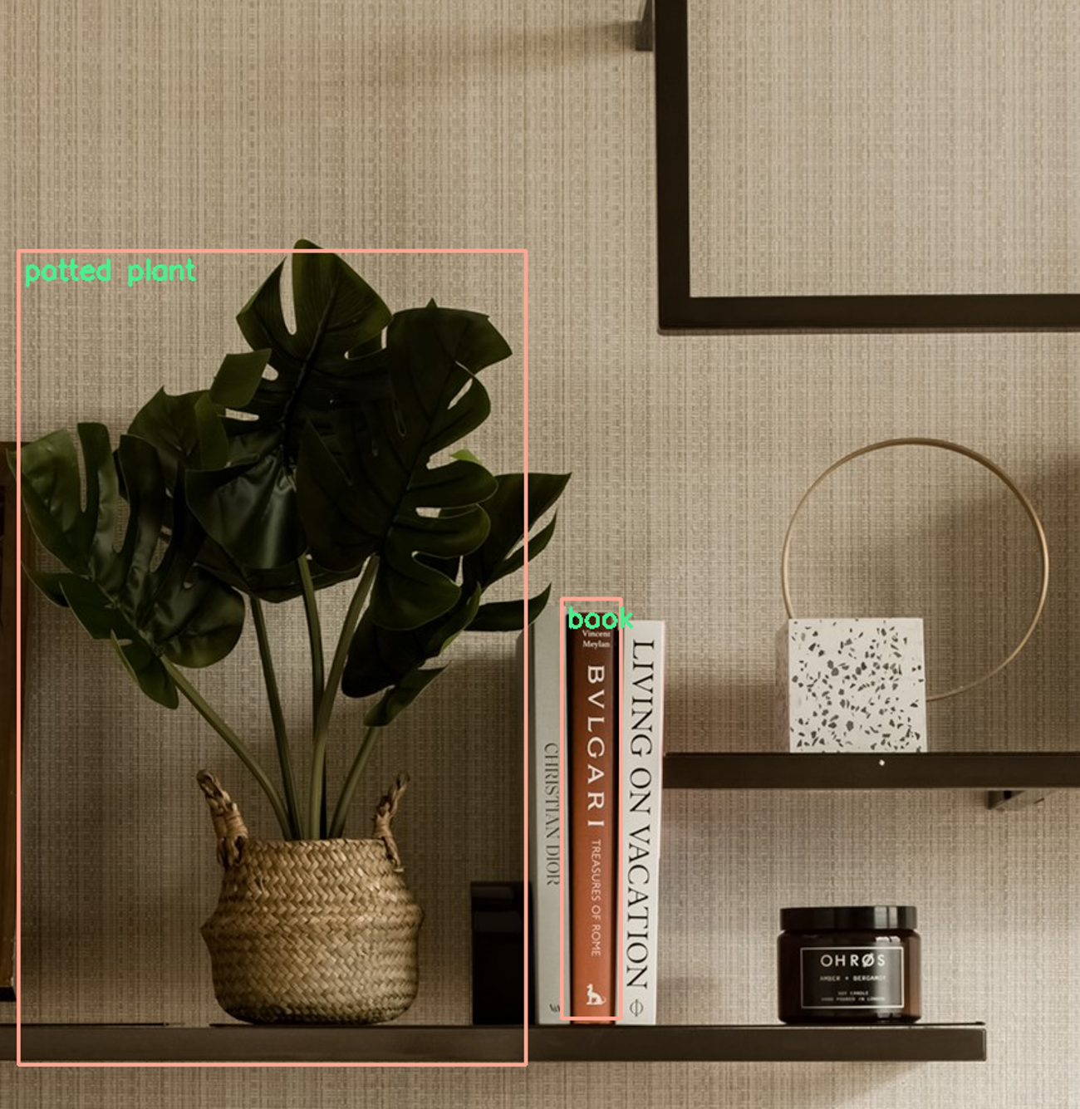





Technologies used
C++ Language
OpenCV
Qt 6
Visual Studio
CMake

Slide 4
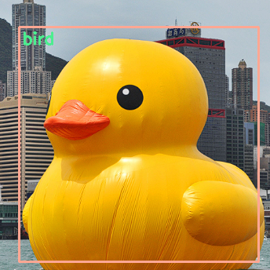
Application Overview
Our application allows users to:
interact with a webcam
capture video feed
upload still images
Users can load local model files and apply object detection to analyze the images.
They can explore basic image processing algorithms to enhance and see how they can affect the results.

Slide 5
Architecture
GUI
Main window
Menu
Status bar
The application follows a straightforward architecture
Separate components for
Graphical User Interface
Webcam interaction
Image processing
Object detection.
Application
Detection
Model loader
Faces
Objects
Utils
Image processing algorithms
Frame status logic (undo/redo)

Slide 6
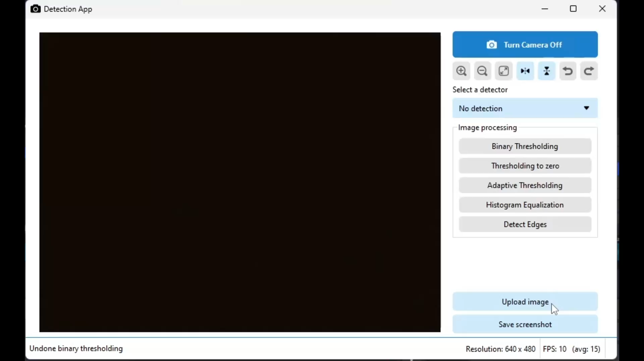
User Interface
Created with the C++ Qt Library
Styled using the QSS syntax
Components:
Image viewer
reimplemented Qt’s QGraphicsView
Custom menu QWidget
With custom checkable buttons
Status bar

Slide 7
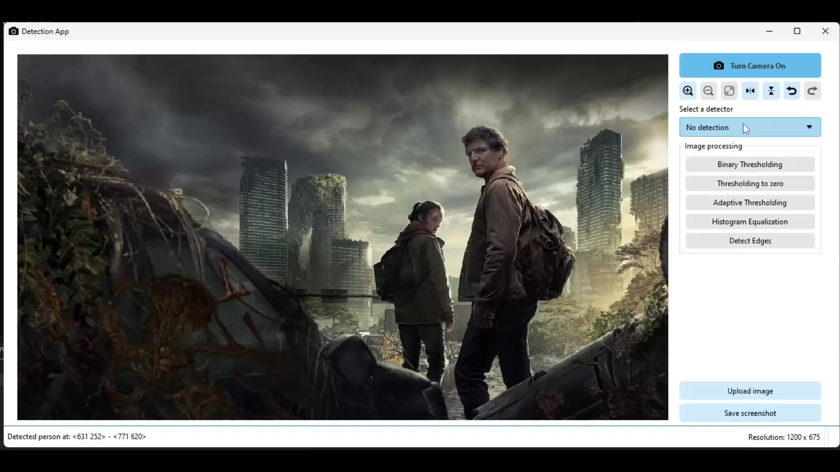
Object Detection
Faces
Haarcascades
Lbpcascades
Objects
Neural network
Needs three files:
Model (*.pb)
Config (*.pbtxt)
Classes (*.txt)
Models are loaded through a JSON file

Slide 8
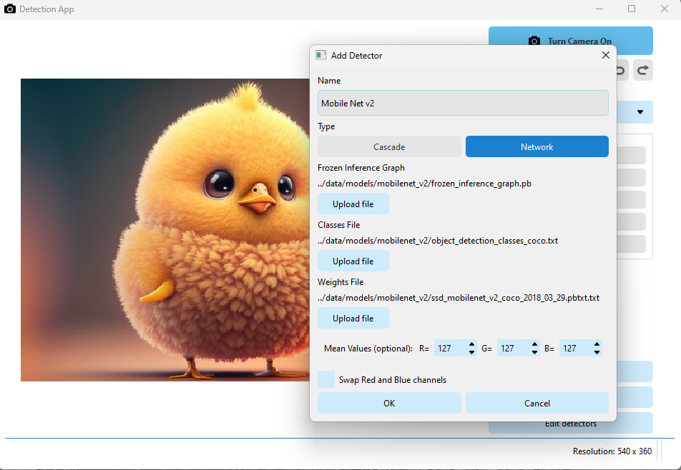

Model loading
You can add models and specify the following properties:
Type (cascade or network)
The path(s) of the model
The mean values for the model (optional)
Whether to swap the red and blue channels (optional)

Slide 9
THANK YOU!
ANY QUESTIONS?

